Slide 1
MODULE 3
http://www.youtube.com/c/EDULINEFORCSE
STUDENTS
1
CHAPTER 1
PACKAGES INTERFACES & EXCEPTION HANDLING
Prepared By Mr.EBIN PM, AP, IESCE

Slide 2
More features of Java:
Packages and Interfaces - Defining Package, CLASSPATH, Access Protection, Importing Packages, Interfaces.
Exception Handling - Checked Exceptions, Unchecked Exceptions, try Block and catch Clause, Multiple catch Clauses, Nested try Statements, throw, throws and finally.
Input/Output - I/O Basics, Reading Console Input, Writing Console Output, PrintWriter Class, Object Streams and Serialization, Working with Files

Slide 3
PACKAGES
A package in Java is used to group related classes and interfaces
Think of it as a folder in a file directory.
We use packages to avoid name conflicts, and to write a better maintainable code
Packages in Java is a mechanism to encapsulate a group of classes, interfaces and sub packages which is used to providing access protection
Package in Java can be categorized in two form,
built-in package
user-defined package
Prepared By Mr.EBIN PM, AP , IESCE

Slide 4
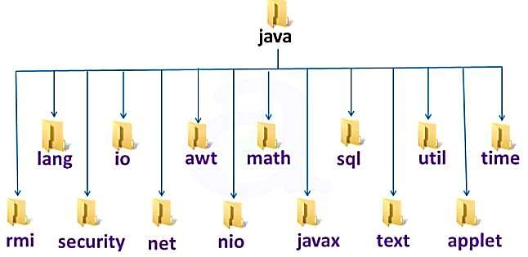
http://www.youtube.com/c/EDULINEFORCSE
STUDENTS
Built-in Package:-Existing Java package. for example, java.io.*, java.lang , java.util etc.
User-defined-package:- Java package created by user to categorized classes and interface

Slide 5
Advantage of Java Package
Java package is used to categorize the classes and interfaces so that they can be easily maintained.
Java package provides access protection.
In real life situation there may arise scenarios where we need to define files of the same name. This may lead to name-space collisions. Java package removes naming collision.
Reusability: Reusability of code is one of the most important requirements in the software industry. Reusability saves time, effort and also ensures consistency. A class once developed can be reused by any number of programs wishing to incorporate the class in that particular program.
Easy to locate the files.
Prepared By Mr.EBIN PM, AP , IESCE

Slide 6
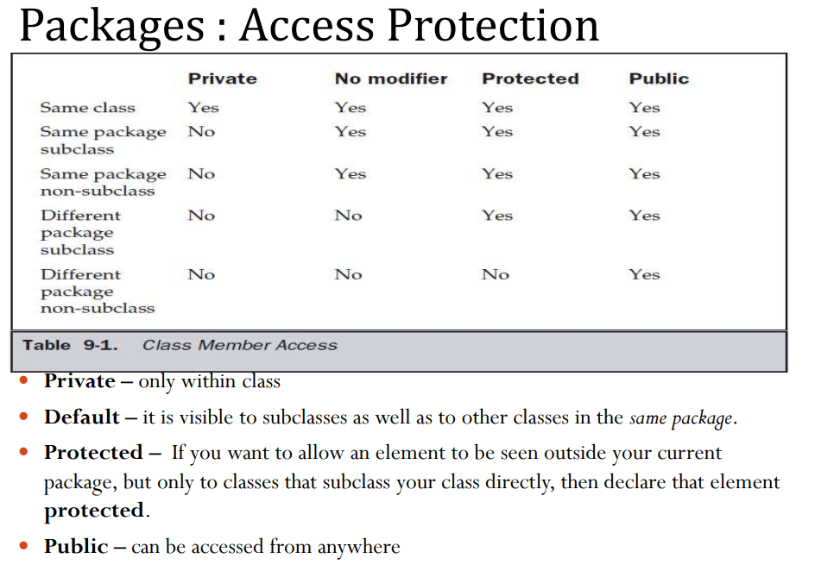

Slide 7
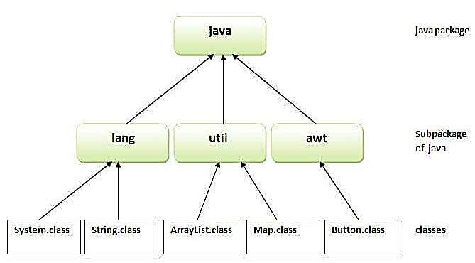
http://www.youtube.com/c/EDULINEFORCSE
STUDENTS
5

Slide 8

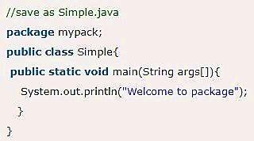
To use a class or a package from the library, we need to use the
import keyword:
Syntax:
The package keyword is used to create a package in java.
Prepared By Mr.EBIN PM, AP , IESCE

Slide 9
Access Packages from another package
http://www.youtube.com/c/EDULINEFORCSE
STUDENTS
There are three ways to access the package from outside the package.
import package.*;
import package.classname; fully qualified name
1. Using packagename.*
If we use packagename.* then all the classes and interfaces of this package will be accessible but not subpackages.
The “import” keyword is used to make the classes and interface of another package accessible to the current package.

Slide 10
Example of package that import the packagename.*
//save as A.java
package pack;
public class A{
public void msg()
{
System.out.println("Hai");
} }
//save as B.java
package mypack;
import pack.*;
class B{
public static void main(String args[]){
A obj = new A();
obj.msg();
} }

Slide 11
2.Using packagename.classname If you import package.classname then only declared class of this package will be accessible
//save as A.java
package pack;
public class A{
public void msg()
{ System.out.println("HeIlo");
} }
//save as B.java
package mypack;
import pack.A;
class B{
public static void main
(String args[]){
A obj = new A();
obj.msg();
} }

Slide 12
3. Using fully qualified name
If we use fully qualified name then only declared class of this package will be accessible.
Now there is no need to import. But you need to use fully qualified name every time when you are accessing the class or interface.
It is generally used when two packages have same class name
e.g. java.util and java.sql packages contain Date class.
Prepared By Mr.EBIN PM, AP, IESCE EDULINE

Slide 13
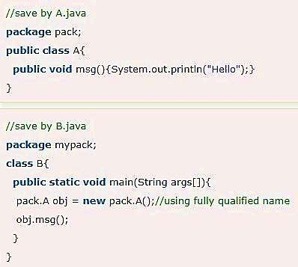
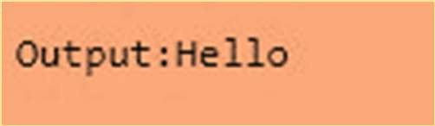
http://www.youtube.com/c/EDULINEFORCSE
STUDENTS
Example of package by import fully qualified name
Notes:
Util Package date in Java is : Wed Mar 17 11:56:06 UTC 2021 SQL Package date in Java : 2021-03-17

Slide 14
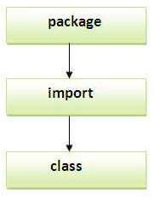
If we import a package, subpackages will not be imported.
If we import a package, all the classes and interface of that package will be imported excluding the classes and interfaces of the subpackages.
Hence, you need to import the subpackage as well Note: Sequence of the program must be package then import then class.
Prepared By Mr.EBIN PM, AP , IESCE

Slide 15
INTERFACE
http://www.youtube.com/c/EDULINEFORCSE
STUDENTS
An interface in Java is a blueprint of a class. It has static constants and abstract methods.
The interface in Java is a mechanism to achieve abstraction. There can be only abstract methods in the Java interface, not method body. It is used to achieve abstraction and multiple inheritance in Java.
In other words, you can say that interfaces can have abstract methods and variables. It cannot have a method body.

Slide 16
Like abstract classes, interfaces cannot be used to create objects
Interface methods do not have a body - the body is provided by the "implement" class
On implementation of an interface, you must override all of its methods
Interface methods are by default abstract and public
Interface attributes are by default public, static and final
An interface cannot contain a constructor (as it cannot be used to create objects)
Prepared By Mr.EBIN PM, AP, IESCE EDULINE
Prepared By Mr.EBIN PM, AP , IESCE

Slide 17
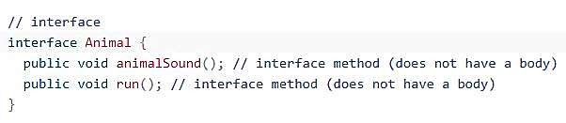
Declare an interface
An interface is declared by using the interface keyword.
It provides total abstraction; means all the methods in an interface are declared with the empty body, and all the fields are public, static and final by default.
A class that implements an interface must implement all the methods declared in the interface.

Slide 18
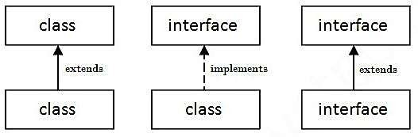
To access the interface methods, the interface must be "implemented“ by another class with the implements keyword (instead of extends).
The body of the interface method is provided by the "implement" class
The relationship between classes and interfaces
As shown in the figure given above, a class extends another class, an interface extends another interface, but a class implements an interface.
Prepared By Mr.EBIN PM, AP , IESCE

Slide 19
interface Animal {
public void animalSound(); // no body
public void sleep(); // no body
}
// A1 "implements" the Animal interface
class A1 implements Animal {
public void animalSound() { // body
System.out.println("A1 says: wee wee");
}
public void sleep() { //body
System. out. println( "Zzz " ) ;
} }
class Inter{
public static void main (String[] args) {
A1 a1=new A1();
// Create A1 object
a1.animalSound( ) ;
a1.sleep() ;
}
}
Output
A1 says: wee wee
Zzz

Slide 20
Why And When To Use Interfaces
To achieve security - hide certain details and only show the important details of an object (interface).
Java does not support "multiple inheritance". However, it can be achieved with interfaces, because the class can implement multiple interfaces.
Note: To implement multiple interfaces, separate them with a comma (see example below).
Prepared By Mr.EBIN PM, AP , IESCE

Slide 21
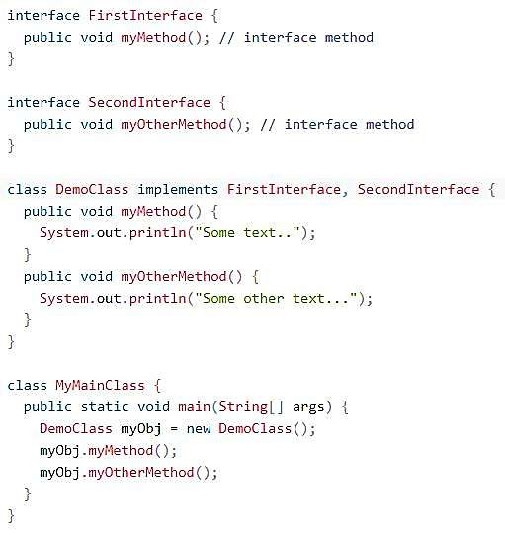

http://www.youtube.com/c/EDULINEFORCSE
STUDENTS
Output

Slide 22
Java program that reads a line of integers, and then displays each integer, and the sum of all the integers input 2 3 4 output 2 3 4 sum of integers=9

Slide 23
Java program that reads a line of integers, and then displays each integer, and the sum of all the integers Algorithm 1.Start 2: Create object of stringTokenizer class using constructor with delimiter argument as space for separating tokens. 3:Enter numbers separated by space. 4: Using appropriate methods, separate tokens (integers) 5.Display the tokens and find the sum of all integers. 6.Stop

Slide 24
import java.util.Scanner; import java.util.StringTokenizer; class StringTokenizerDemo { public static void main(String args[]) { int n,sum = 0; Scanner sc = new Scanner(System.in); System.out.println("Enter integers with one space gap:"); String s = sc.nextLine(); StringTokenizer st = new StringTokenizer(s, “ "); while (st.hasMoreTokens()) { String temp = st.nextToken(); n = Integer.parseInt(temp); System.out.println(n); sum = sum + n; } System.out.println("sum of the integers is: " + sum); } }

Slide 25
EXCEPTION HANDLING
Exception is an abnormal condition.
In Java, an exception is an event that disrupts the normal flow of the program. It is an object which is thrown at runtime.
Exception Handling is a mechanism to handle runtime errors such as ClassNotFoundException, IOException, SQLException, RemoteException, etc.
The core advantage of exception handling is to maintain the normal flow of the application.
An exception normally disrupts the normal flow of the application that is why we use exception handling.
Prepared By Mr.EBIN PM, AP , IESCE

Slide 26
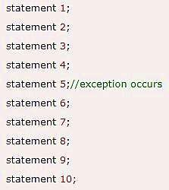
http://www.youtube.com/c/EDULINEFORCSE
STUDENTS
Let's take a scenario:
Suppose there are 10 statements in your program and there occurs an exception at statement 5, the rest of the code will not be executed i.e. statement 6 to 10 will not be executed.
If we perform exception handling, the rest of the statement will be executed. That is why we use exception handling in Java.

Slide 27
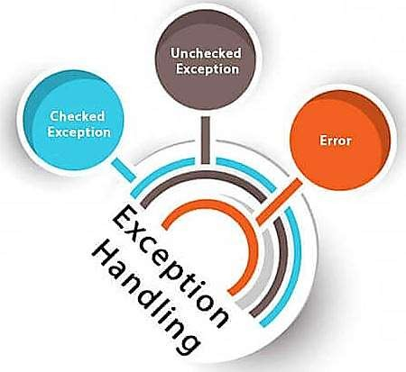
Types of Java Exceptions
There are mainly two types of exceptions: checked and unchecked.
Here, an error is considered as the unchecked exception.
According to Oracle, there are three types of exceptions:
Checked Exception Unchecked Exception Error
Prepared By Mr.EBIN PM, AP , IESCE

Slide 28
http://www.youtube.com/c/EDULINEFORCSE
STUDENTS
Checked Exception
The classes which directly inherit Throwable class except RuntimeException and Error are known as checked exceptions
e.g. IOException, SQLException etc.
Checked exceptions are checked at compile-time.
Unchecked Exception
The classes which inherit RuntimeException are known as unchecked exceptions
e.g. ArithmeticException, NullPointerException,
Unchecked exceptions are not checked at compile-time, but they are checked at runtime

Slide 29


Slide 30
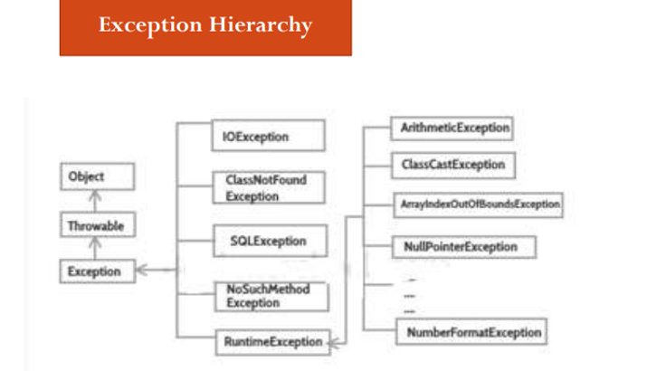

Slide 31
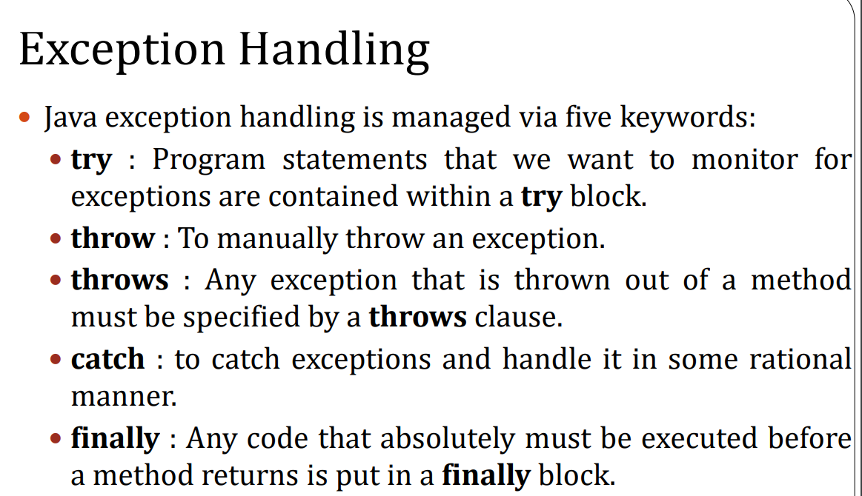

Slide 32
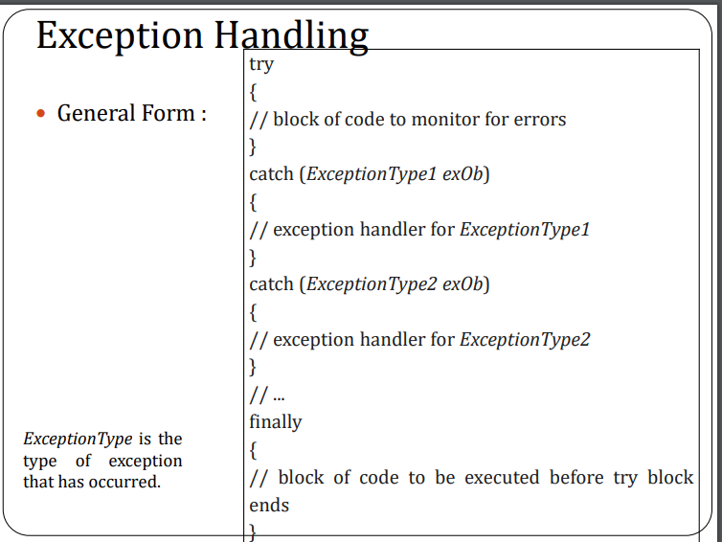

Slide 33
http://www.youtube.com/c/EDULINEFORCSE
STUDENTS
Common Scenarios of Java Exceptions
A scenario where ArithmeticException occurs
If we divide any number by zero, there occurs an ArithmeticException. int a=50/0; //ArithmeticException
A scenario where NullPointerException occurs
If we have a null value in any variable, performing any operation on the variable throws a NullPointerException.
String s=null;
System.out.println(s.length()); //NullPointerException

Slide 34
A scenario where NumberFormatException occurs
The wrong formatting of any value
may occur
NumberFormatException. Suppose I have a string variable that has characters, converting this variable into digit will occur NumberFormatException.
String s="abc";
int i=Integer.parseInt(s);//NumberFormatException
A scenario where ArrayIndexOutOfBoundsException occurs
If you are inserting any value in the wrong index, it would result in ArrayIndexOutOfBoundsException as shown below:
int a[]=new int[5];
a[10]=50; //ArrayIndexOutOfBoundsException

Slide 35
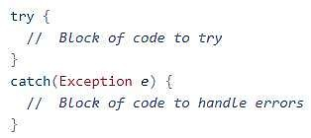
http://www.youtube.com/c/EDULINEFORCSE
STUDENTS
TRY & CATCH
The try statement allows you to define a block of code to be
tested for errors while it is being executed.
The catch statement allows you to define a block of code to be executed, if an error occurs in the try block.
The try and catch keywords come in pairs
Syntax
Prepared By Mr.EBIN PM, AP, IESCE EDULINE

Slide 36
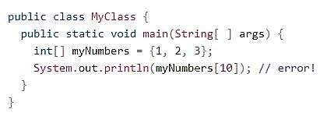
Consider the following example
This will generate an error, because myNumbers[10] does not exist.
If an error occurs, we can use try...catch to catch the error and execute some code to handle it
Prepared By Mr.EBIN PM, AP, IESCE EDULINE
Prepared By Mr.EBIN PM, AP , IESCE

Slide 37
public class myClass
{
public static void main(String[] args)
{
try {
int[] myNumbers ={1,2,3};
System. out. println ( myNumbers [10] ) ;
}
catch (Exception e)
{
System.out.println( "Something went wrong.");
}
}
}

Slide 38
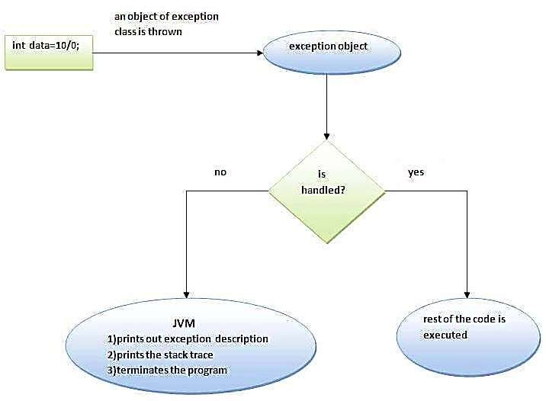
Internal working of java try-catch block
Prepared By Mr.EBIN PM, AP , IESCE

Slide 39
http://www.youtube.com/c/EDULINEFORCSE
STUDENTS
The JVM firstly checks whether the exception is handled or not. If exception is not handled, JVM provides a default exception handler that performs the following tasks:
Prints out exception description.
Prints the stack trace (Hierarchy of methods where the exception occurred).
Causes the program to terminate.
But if exception is handled by the application programmer, normal flow of the application is maintained i.e. rest of the code is executed.

Slide 40
Multi-catch block
A try block can be followed by one or more catch blocks. Each catch block must contain a different exception handler. So, if you have to perform different tasks at the occurrence of different exceptions, use java multi-catch block.
At a time only one exception occurs and at a time only one catch block is executed.
All catch blocks must be ordered from most specific to most general, i.e. catch for ArithmeticException must come before catch for Exception.
Prepared By Mr.EBIN PM, AP , IESCE

Slide 41

public class MultipleCatch{
public static void main(String[] args){
try
{
int a[]=new int[5];
a[5]=30/0;
}
catch(ArithmeticException e) {
System.out.println("Arithmetic Exception occurs");
}
catch(ArrayIndexOutOfBoundsException e) {
System.out.println("ArrayIndexOutOfBoundsException occurs");
}
catch(Exception e) {
System.out.println("Parent Exception occurs");
}
}
}

Slide 42
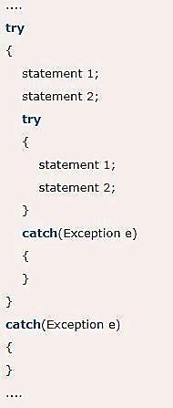
Nested try block
The try block within a try block is known as nested try block in java.
Sometimes a situation may arise where a part of a block may cause one error and the entire
block itself may cause another error. In such cases, exception handlers have to be nested.
Prepared By Mr.EBIN PM, AP , IESCE

Slide 43

class Excep6{
public static void main(String args[]){
try{
try{
System.out.println("going to divide");
int b =39/0;
}
catch(ArithmeticException e)
{System.out.println(e);}
try{
int a[]=new int[5];
}catch(ArrayIndexOutOfBoundsException e)
{System.out.println(e);
}
System.out.println("other statement");
}catch(Exception e)
{
System.out.println("Parent exception");
}
System.out.println("normal flow..");
}}

Slide 44
finally block
Java finally block is a block that is used to execute important code such as closing connection, stream etc.
Java finally block is always executed whether exception is handled or not.
Java finally block follows try or catch block.
Note: If you don't handle exception, before terminating the program, JVM executes finally block(if any).
Prepared By Mr.EBIN PM, AP , IESCE

Slide 45
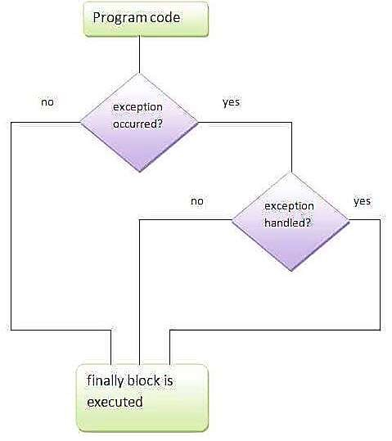
OOPJ
http://www.youtube.com/c/EDULINEFORCSE
STUDENTS

Slide 46
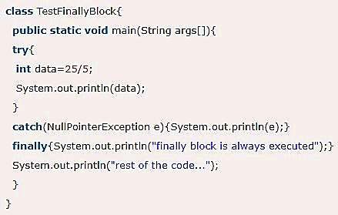

Usage of Java finally
Case 1 - Let's see the java finally example where exception doesn't occur.
Prepared By Mr.EBIN PM, AP, IESCE EDULINE
Prepared By Mr.EBIN PM, AP , IESCE

Slide 47
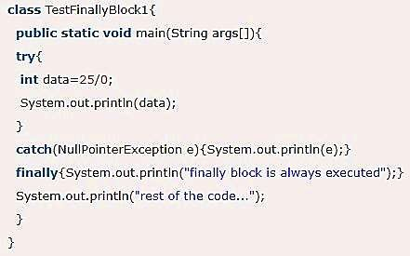

Case 2 - Let's see the java finally example where exception occurs and not handled.
OOPJ
http://www.youtube.com/c/EDULINEFORCSE
STUDENTS

Slide 48
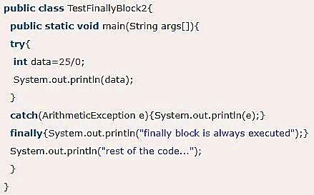

Case 3 - Let's see the java finally example where exception occurs and handled
Prepared By Mr.EBIN PM, AP , IESCE

Slide 49
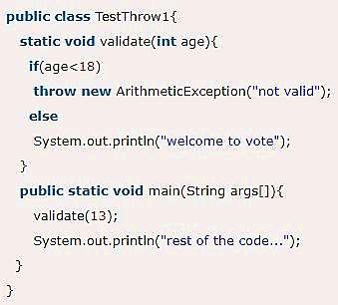
http://www.youtube.com/c/EDULINEFORCSE
STUDENTS
throw keyword
The Java throw keyword is used to explicitly throw an exception.
We can throw either checked or uncheked exception in java by throw keyword
Output

Slide 50
throws keyword
The Java throws keyword is used to declare an exception.
It gives an information to the programmer that there may occur an exception so it is better for the programmer to provide the exception handling code so that normal flow can be maintained
Exception Handling is mainly used to handle the checked exceptions.
If there occurs any
unchecked exception programmers fault that
such as he is not
NullPointerException, it is
performing check up before the code being used.

Slide 51

http://www.youtube.com/c/EDULINEFORCSE
STUDENTS
Syntax of java throws
Which exception should be declared
checked exception only, because:
unchecked Exception: under your control so correct your code.
error: beyond your control e.g. you are unable to do anything if there occurs VirtualMachineError or StackOverflowError.

Slide 52
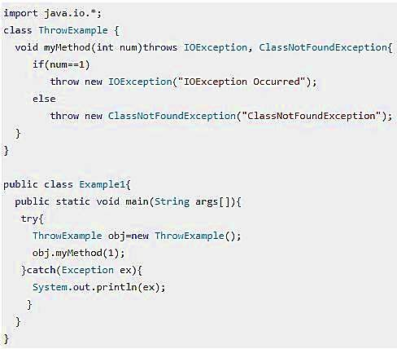

Eg:
Output
Prepared By Mr.EBIN PM, AP , IESCE

